Slide 1
An Introduction to Liver disease and Investigations in liver disease
PROF ANURADHA DASSANAYAKE

Slide 2
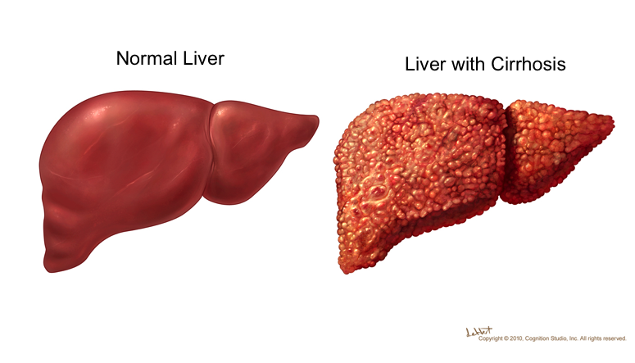

Slide 3
Common Liver diseases in Sri Lanka
Acute Presentations
  Viral Hepatitis(A,B, Dengue, IM,EBV ect)
  Alcoholic Hepatitis
  Leptospirosis
  Non Alcoholic Steato Hepatitis(NASH)
  Drug/Herbal medicine/Toxin induced hepatitis(Anti TB, lipid lowering)
  Auto immune hepatitis

Slide 4
Cirrhosis
Alcoholic Cirrhosis
Cryptogenic Cirrhosis
Hepatitis B/ Hepatitis C
Wilson’s Disease
Haemochromatosis
Auto immune hepatitis

Slide 5
Biochemical Investigations
Serum Transaminases(ALT/AST)
Alkaline phosphatase
Gamma GT
Serum Bilirubin
Serum proteins

Slide 6
FBC
Hb could be low
  Bleeding
  Poor nutrition
WBC low
  Hypersplenism
Low platelets-
  Some times the presenting feature
  Hypersplenism

Slide 7
Alpha fetoproteins
High in about 50 % of patients with hepatoma
Also high in testicular tumors
If very high is a poor prognostic factor.

Slide 8
Serum Transaminases
ALT(SGPT) is liver specific
AST(SGOT) is found in muscle & RBC
  Used to diagnose MI
Very high levels are found in viral hepatitis
Not very high in obstruction
May be normal in cirrhosis
ALT/AST ratio useful in certain liver disease

Slide 9
Serum Bilirubin
High in obstruction
  direct
  (Intra hepatic, Extra hepatic)
Haemolysis- Indirect
Dubin Jhonson syndrome- Direct
Gibert syndrome-indirect

Slide 10
Alkaline phosphatase
Obstruction
  Intra hepatic(PBC,PSC)
  Extra hepatic(Gallstones,Ca)
  Focal lesions- Hepatoma/abcess
Bone disease
Child hood
Pregnancy

Slide 11
Gamma GT
Hepatitis
Obstruction
Enzyme induction
  Alcohol
  Anti convulsants

Slide 12
Serum Proteins
Low serum Albumin
Reversal of the albumin globulin ratio
Low albumin is also found in
  Nephrotic syndrome
  Malabsorption

Slide 13
Individual Liver illnesses
Haemochromatosis
  Ferritin
  FE/TIBC
  Genetic HFE gene
Wilsons D
  Serum Caeruloplasmin
  24 hour urinary Cu excretion
  KF ring
PBC
  AMA
AIH
  ANF/ASMA
PSC
  MRCP/ERCP

Slide 14
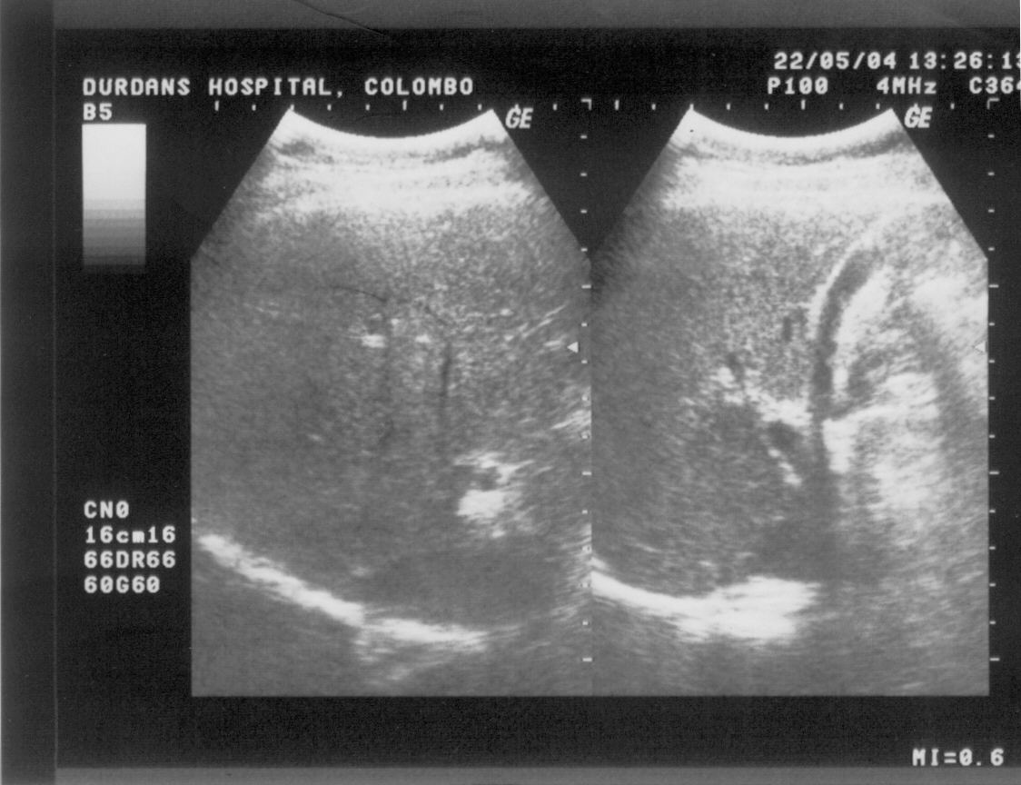
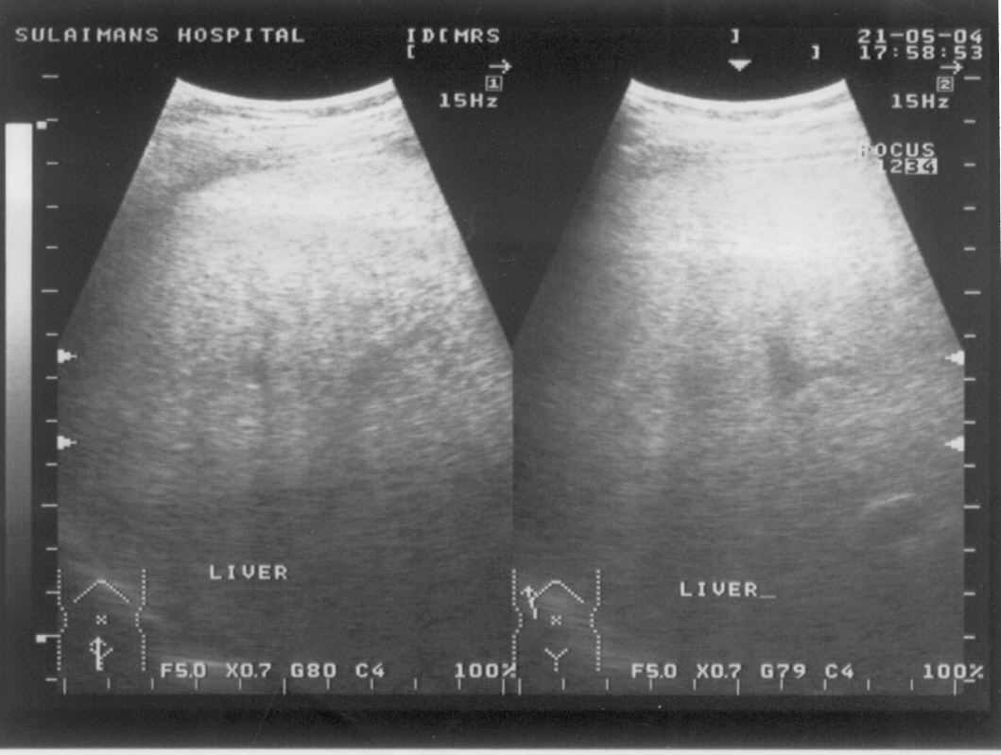
Imaging – ultrasonography
Normal
Bright liver / fatty liver
Lornado 1997 – 19.8%
Bellentani 2001- 16% (Dionysos study)

Slide 15
Ultrasonography
In cirrhosis
  Small contracted nodular liver
  Splenomeaglly
  Portal vein size, flow direction
  Ascites
  SOL

Slide 16
Ultrasonography
Useful in the diagnosis of focal lesions as well
  Hepatoma
  Haemangioma
  Liver abcesses
  Secondary deposists

Slide 17
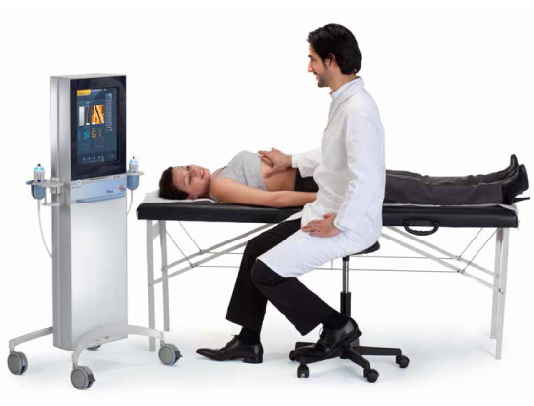
Fibro scan

Slide 18
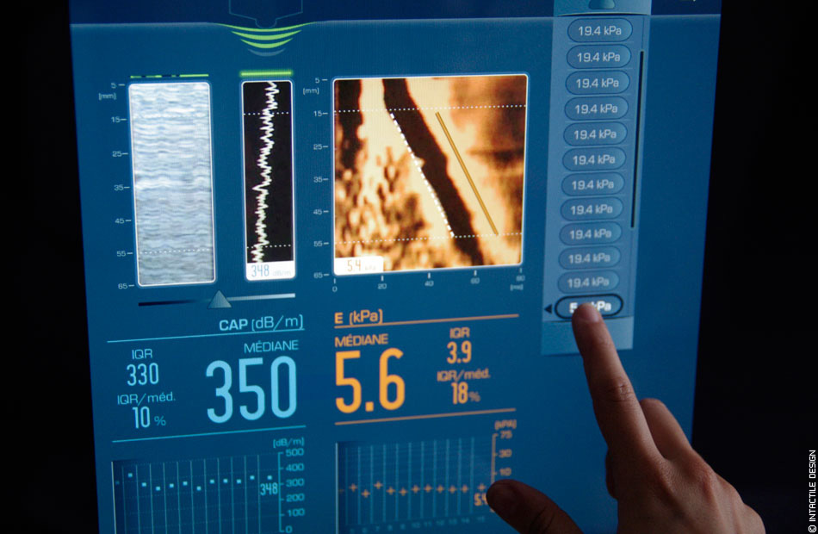

Slide 19
CT/MRI
Very usefull in diagnosing cirrhosis
Hepatoma & other focal lesions
Portal vein thrombosis

Slide 20
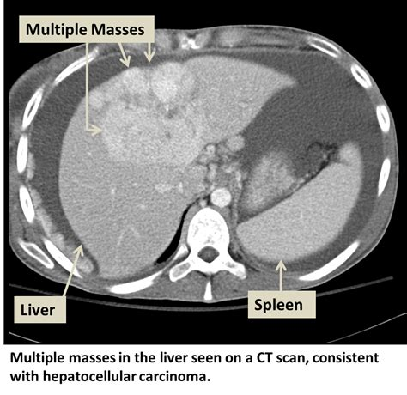

Slide 21
ERCP/MRCP
Both very useful in diagnosing biliary obstruction.
MRCP non invasive
ERCP invasive but therapeutic as well
  Stone removal
  Stenting.

Slide 22
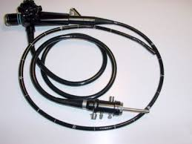

Slide 23
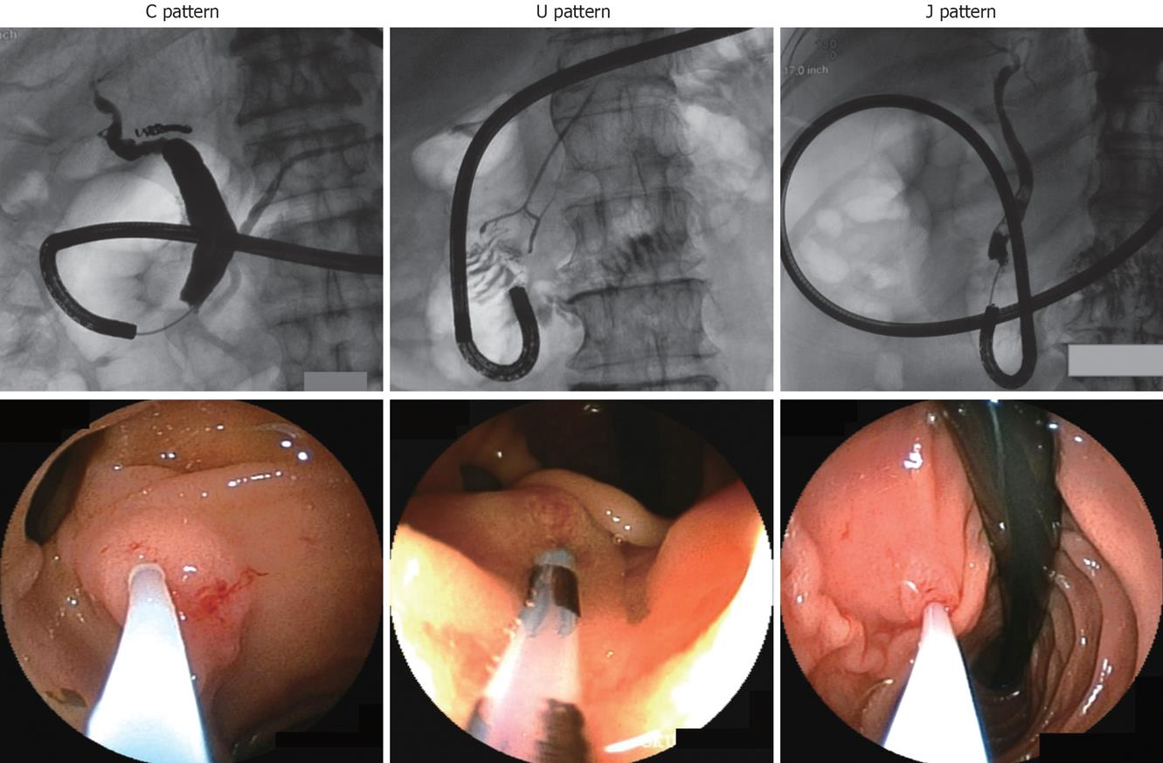

Slide 24
Liver biopsy
Invasive
  Percutaneous/Transjugular/Open
  US guided/Blind
Gold standard in the diagnosis of liver disease
May not be useful in cirrhosis

Slide 25
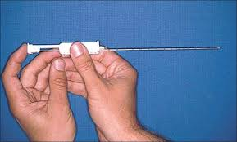

Slide 26
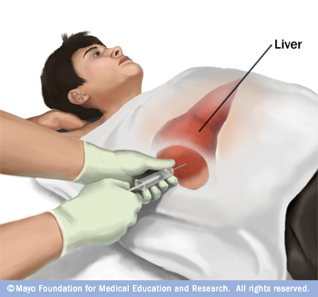

Slide 27
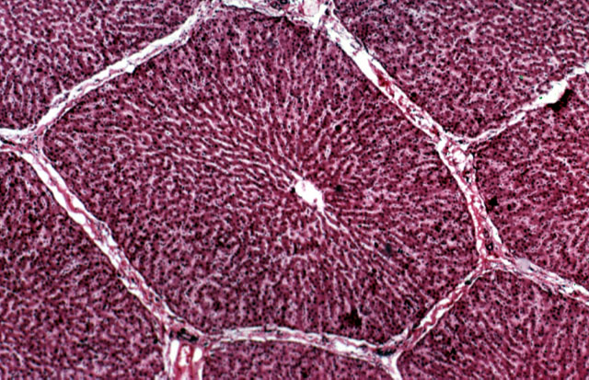
Normal liver

Slide 28
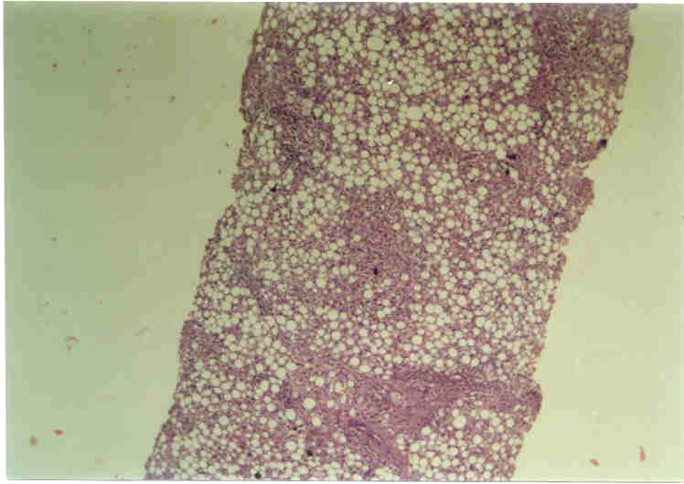
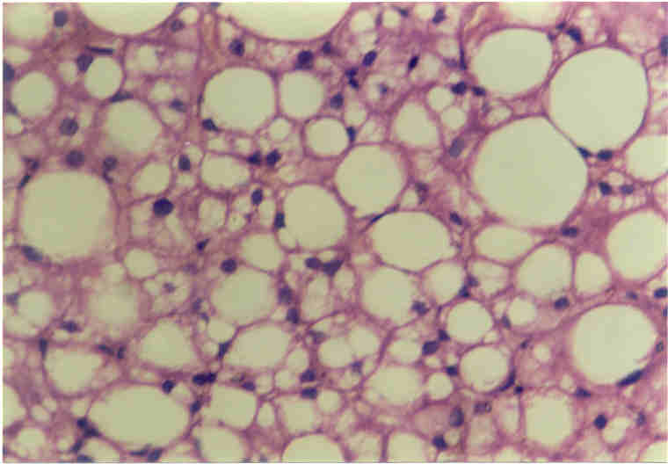
Steatosis
Grade 1 ( upto 33%)
Grade 2 (33% - 66%)
Grade 3 (>66%)

Slide 29
Diagnosis of CLD/Cirrhosis
Biochemical- Serum proteins
Low albumin with reversal of A/G ratio
US scan/CT
Biopsy
OGD
Platelet count

Slide 30
Endoscopy-Varices/PHG
All patients with chronic liver disease should have an upper GI endoscopy

Slide 31


Slide 32
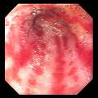

Slide 33
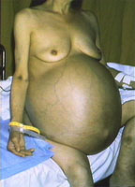

Slide 35
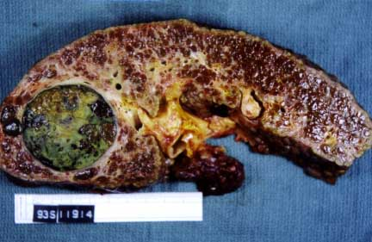

Slide 36
Hepatoma
Should be diagnosed early-Place for screening
Diagnosis is radiological-Contrast CT/MRI
Serum alpha fetoprotein level is useful in the diagnosis.

